Slide 1


Pilot Study Update
Client: Exyte
Location: Singapore
Date : 24 Jan 2024

Slide 2
Discussion points
First round of sample collection started on 23rd Jan 24, will end on 28 Jan 24
Micron LSR HFW Sampling Log.xlsx

Slide 3
HFW and LSR sampling points – Run 1
Sampling points | Volume (L) | Total volume for each collection (L) | Frequency per week | Total quantity per week (L)
HFW
HFW Gravity Drain A1 | 70 | 100 | 10 | 1000 (1m³)
HFW Gravity Drain A2 | 30
HFW Gravity Drain Chem Room | 2* | 2 |  | 20
HFW Gravity Drain Corrosive gas room | 2* | 2
 |  |  |  | 20
LSR A2
LSR A2 transfer pump | 100 | 100 | 10 | 1000 (1m³)
Ratio HFW A1: A2= 7:3
*Collect in two separate 20 L carboys and mixing will be done in GIH lab, LSR A1 feed is not required
Sample to be collected once per 12-hour shift

Slide 4
HFW and LSR sampling points – Run 2
Sampling points | Volume (L) | Total volume (L) | Frequency per week | Total quantity per week (L)
HFW
HFW Gravity Drain A1 | 280 | 400 | 10 | 4000 (4m³)
HFW Gravity Drain A2 | 120
HFW Gravity Drain Chem Room | 8* | 8 |  | 80
HFW Gravity Drain Corrosive gas room | 8* | 8
 |  |  |  | 80
LSR A2
LSR A2 transfer pump | 400 | 400 | 10 | 4000 (4m³)
*Collect in 8x separate 20 L carboys and mixing will be done in GIH lab, LSR A1 feed is not required
Sample to be collected once per 12-hour shift

Slide 5
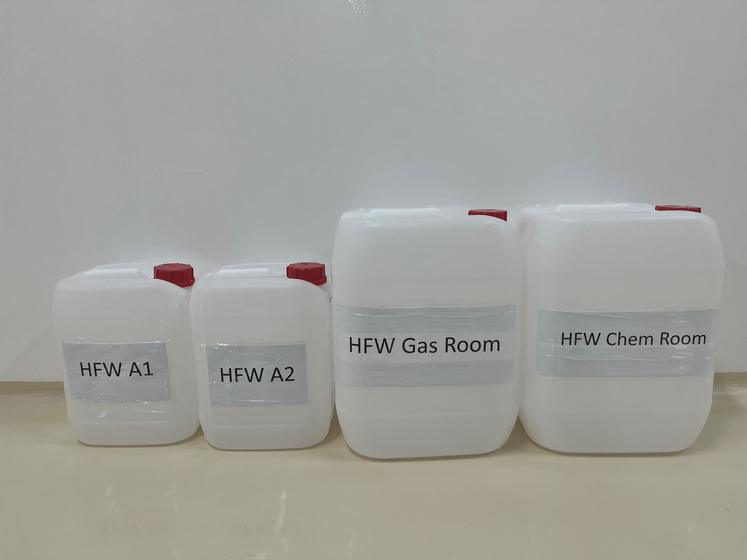
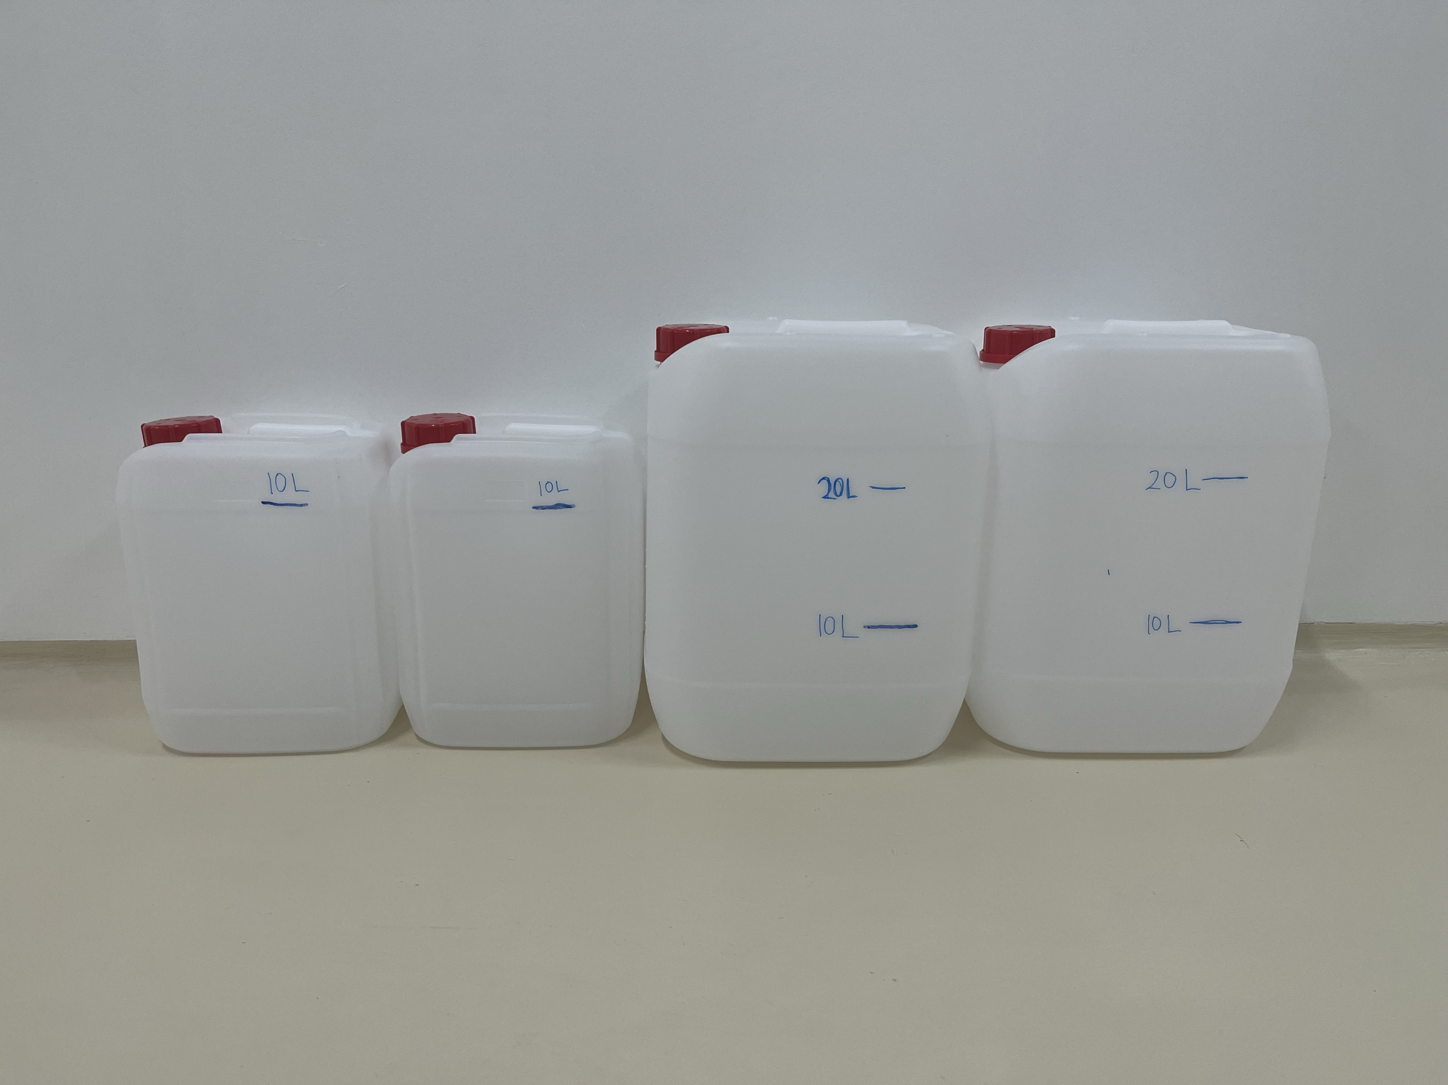
Sampling plan

Slide 6
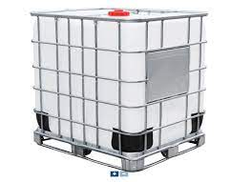
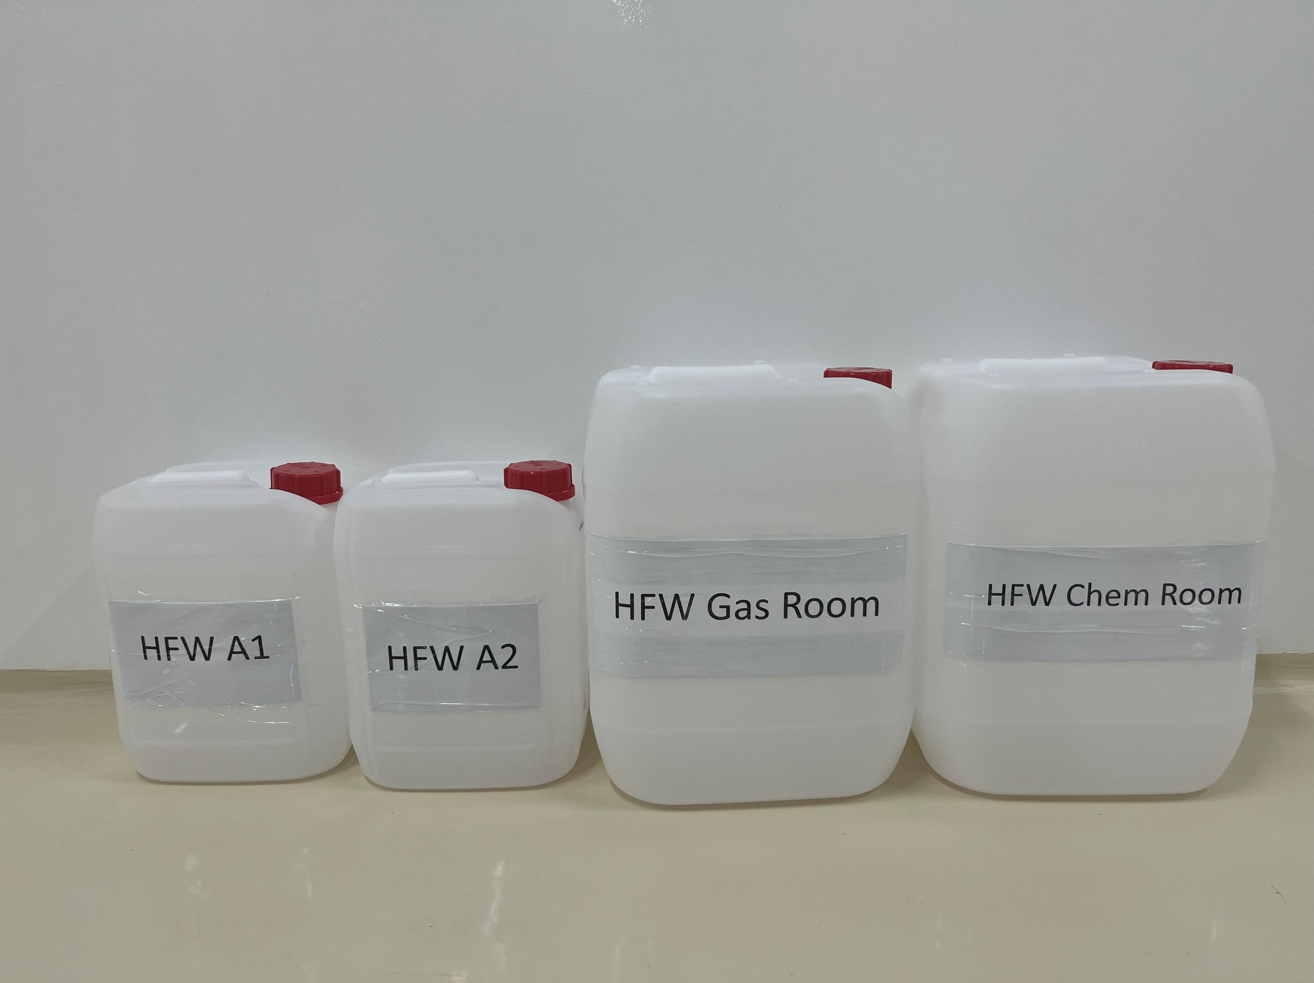
Sampling plan for HFW A1 and A2
7x 10 L
2 collections each day for 5 days
1 collection per shift
18 – 22 Jan 2024
3x 10 L

Slide 7

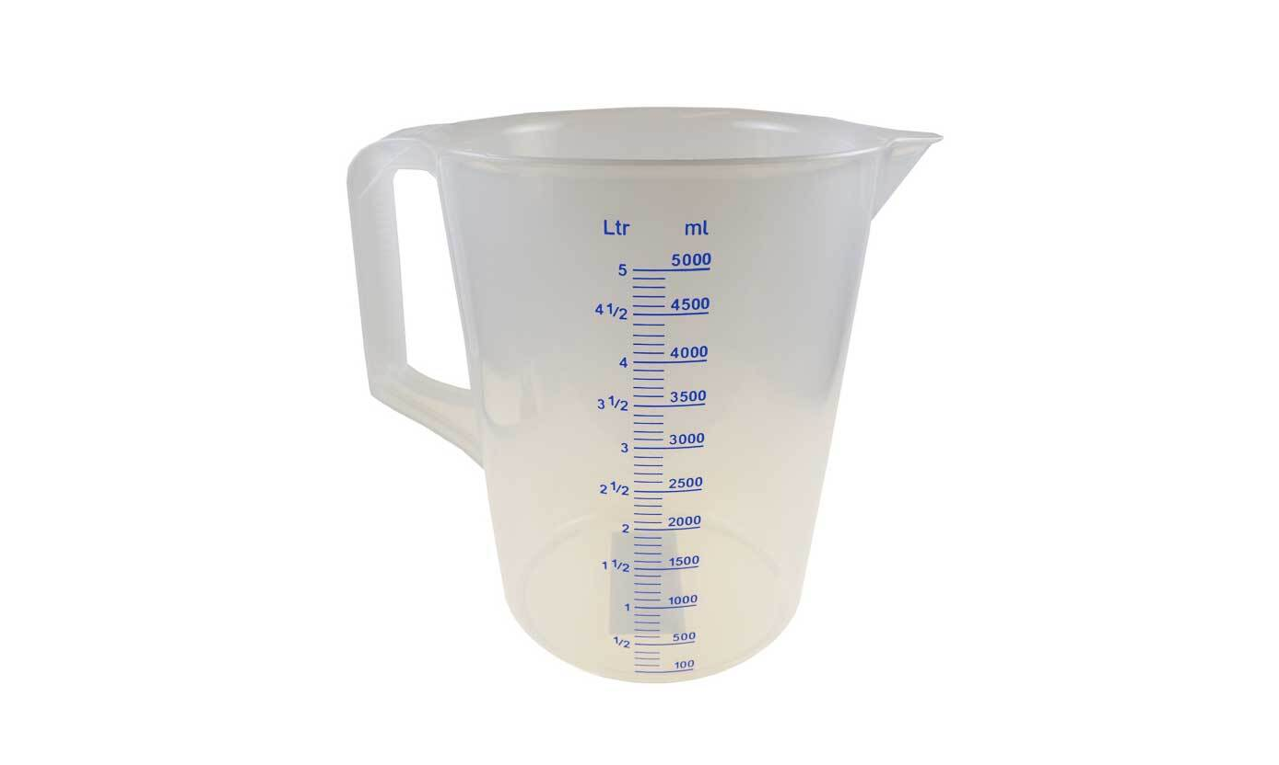

Sampling plan for HFW Chem Room and Gas Room
2 L
2 L

Slide 8
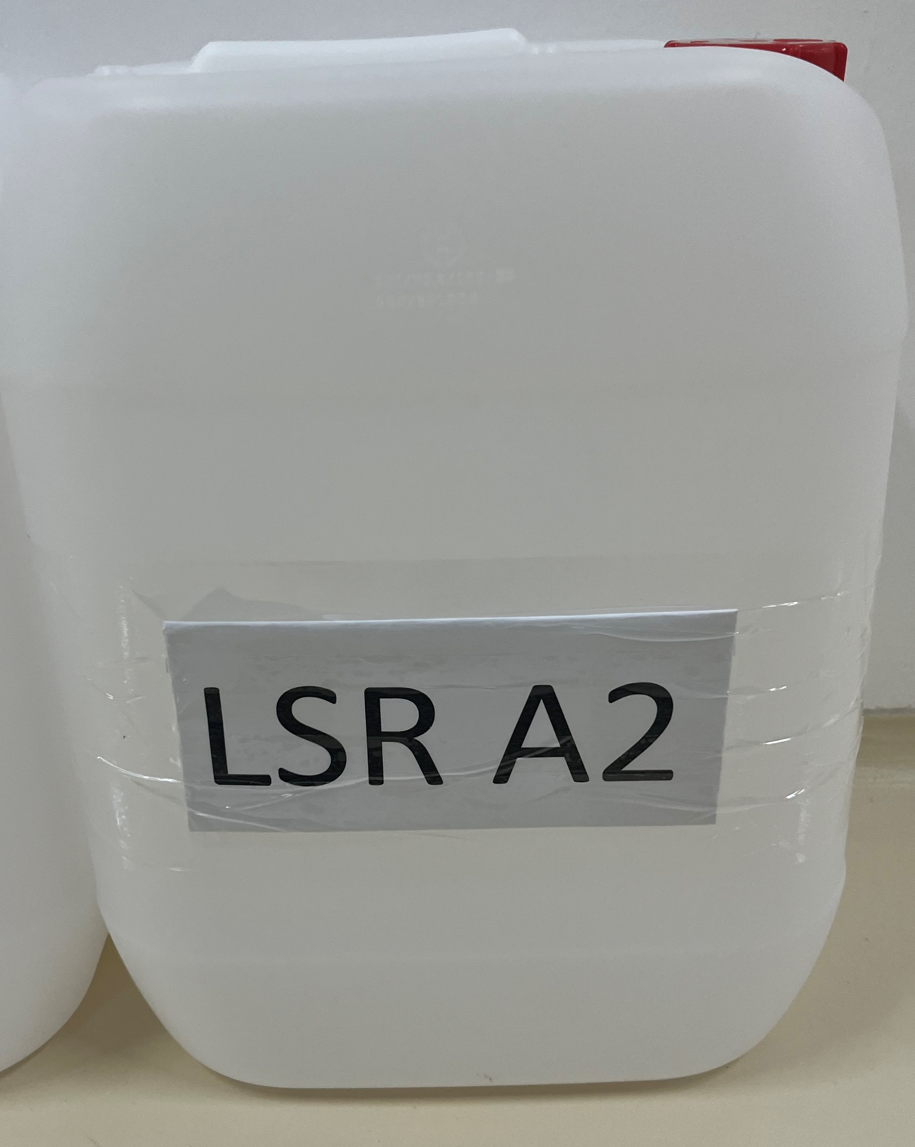
Sampling plan for LSR A2
5x 20 L
2 collections each day for 5 days
1 collection per shift
18 – 22 Jan 2024

Slide 9
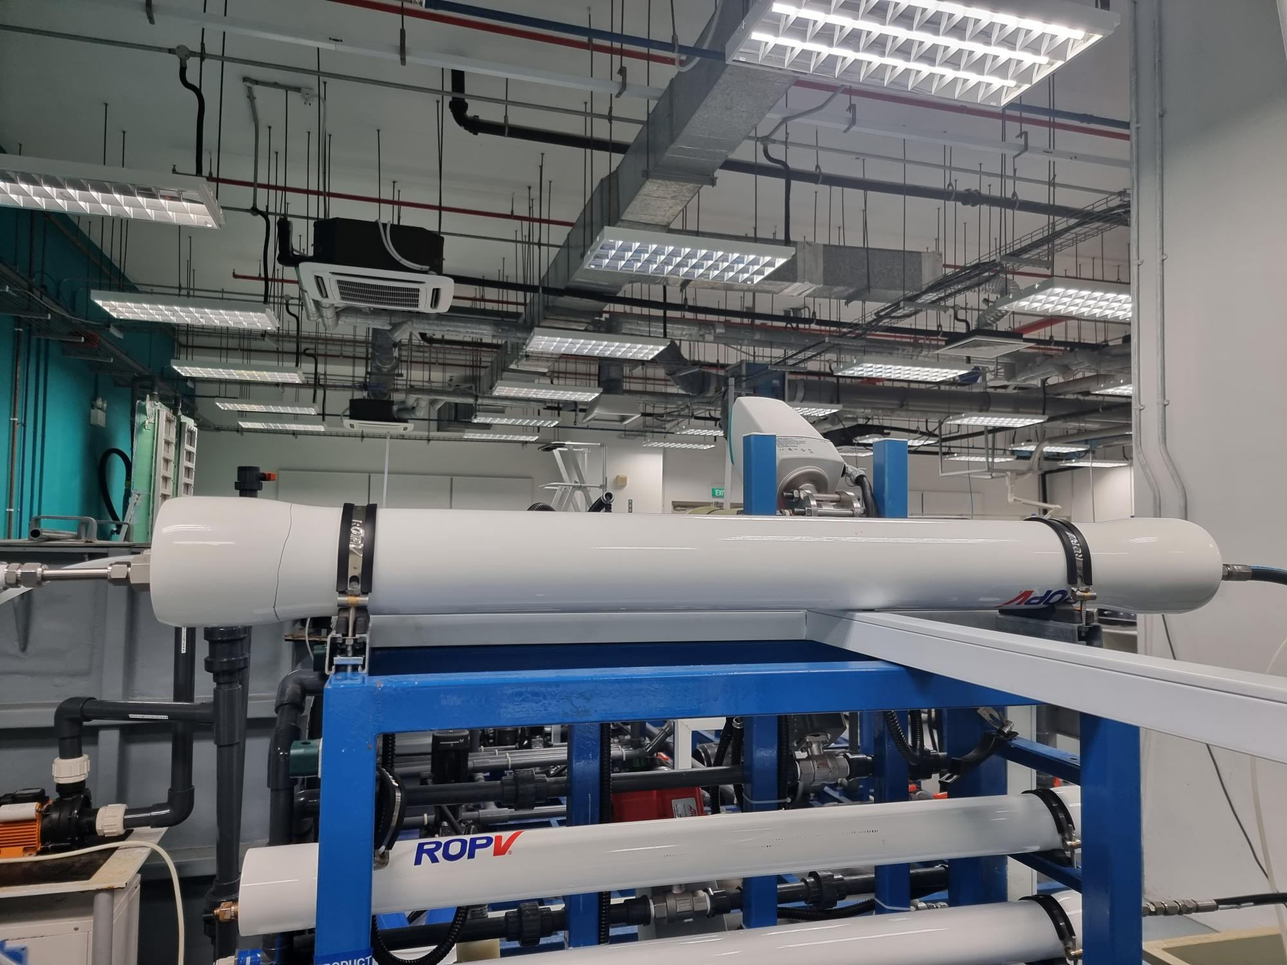
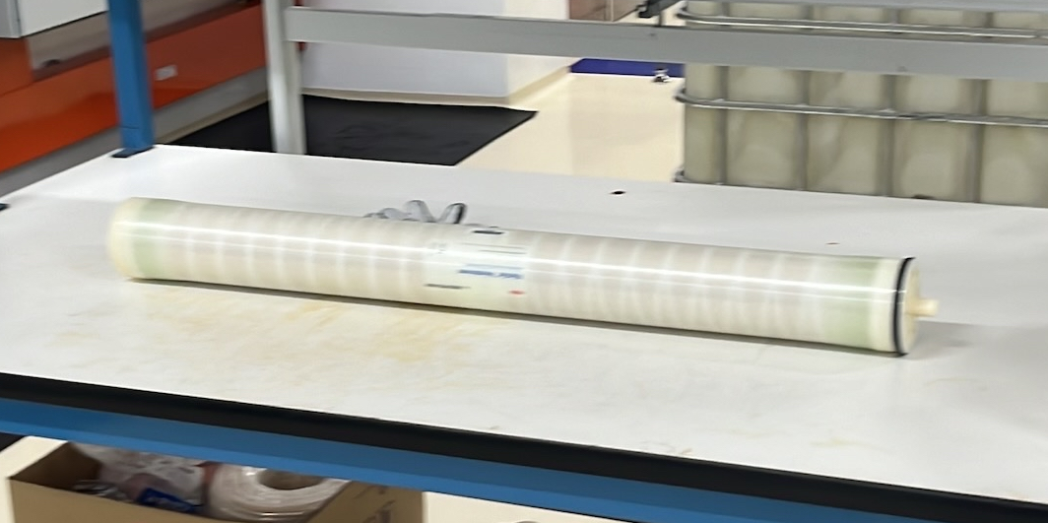
Pilot setup – membrane and pressure vessel
BW30 PRO-4040

Slide 10
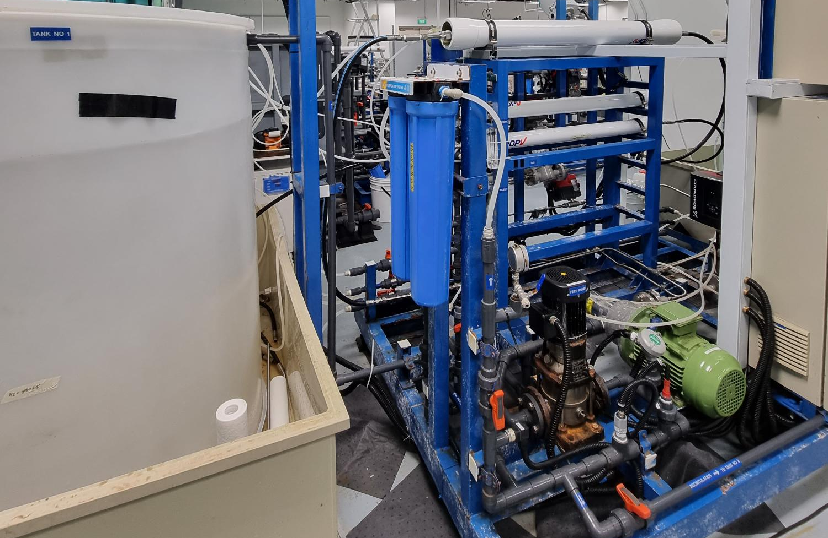
BW30 PRO-4040
Cartridge filter
Feed tank
Booster pump
High pressure pump

Slide 11
Schedule
Event | Description | Date
01 | Pilot Readiness | 25-Jan
02 | Sample Collection at Site | 18-Jan to 25-Jan 23 Jan – 2 Feb
03 | Micron/Exyte witness | 01-Feb (?) - to be confirmed by Kristine and get back tomorrow
04 | Pilot Operation | 26-Jan to 08-Feb
05 | Report Preparation | 09-Feb to 22-Feb
06 | Draft Submission Review | 23-Feb to 07-Mar
07 | Final Report Submission | 08-Mar to 15-Mar

Slide 12


